Slide 1


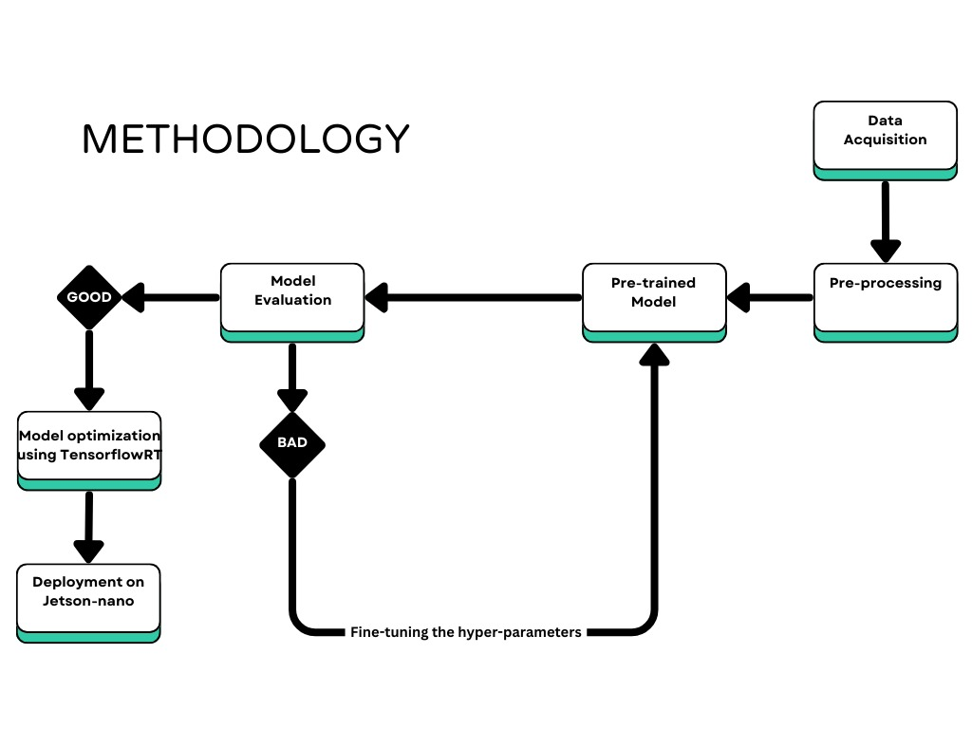
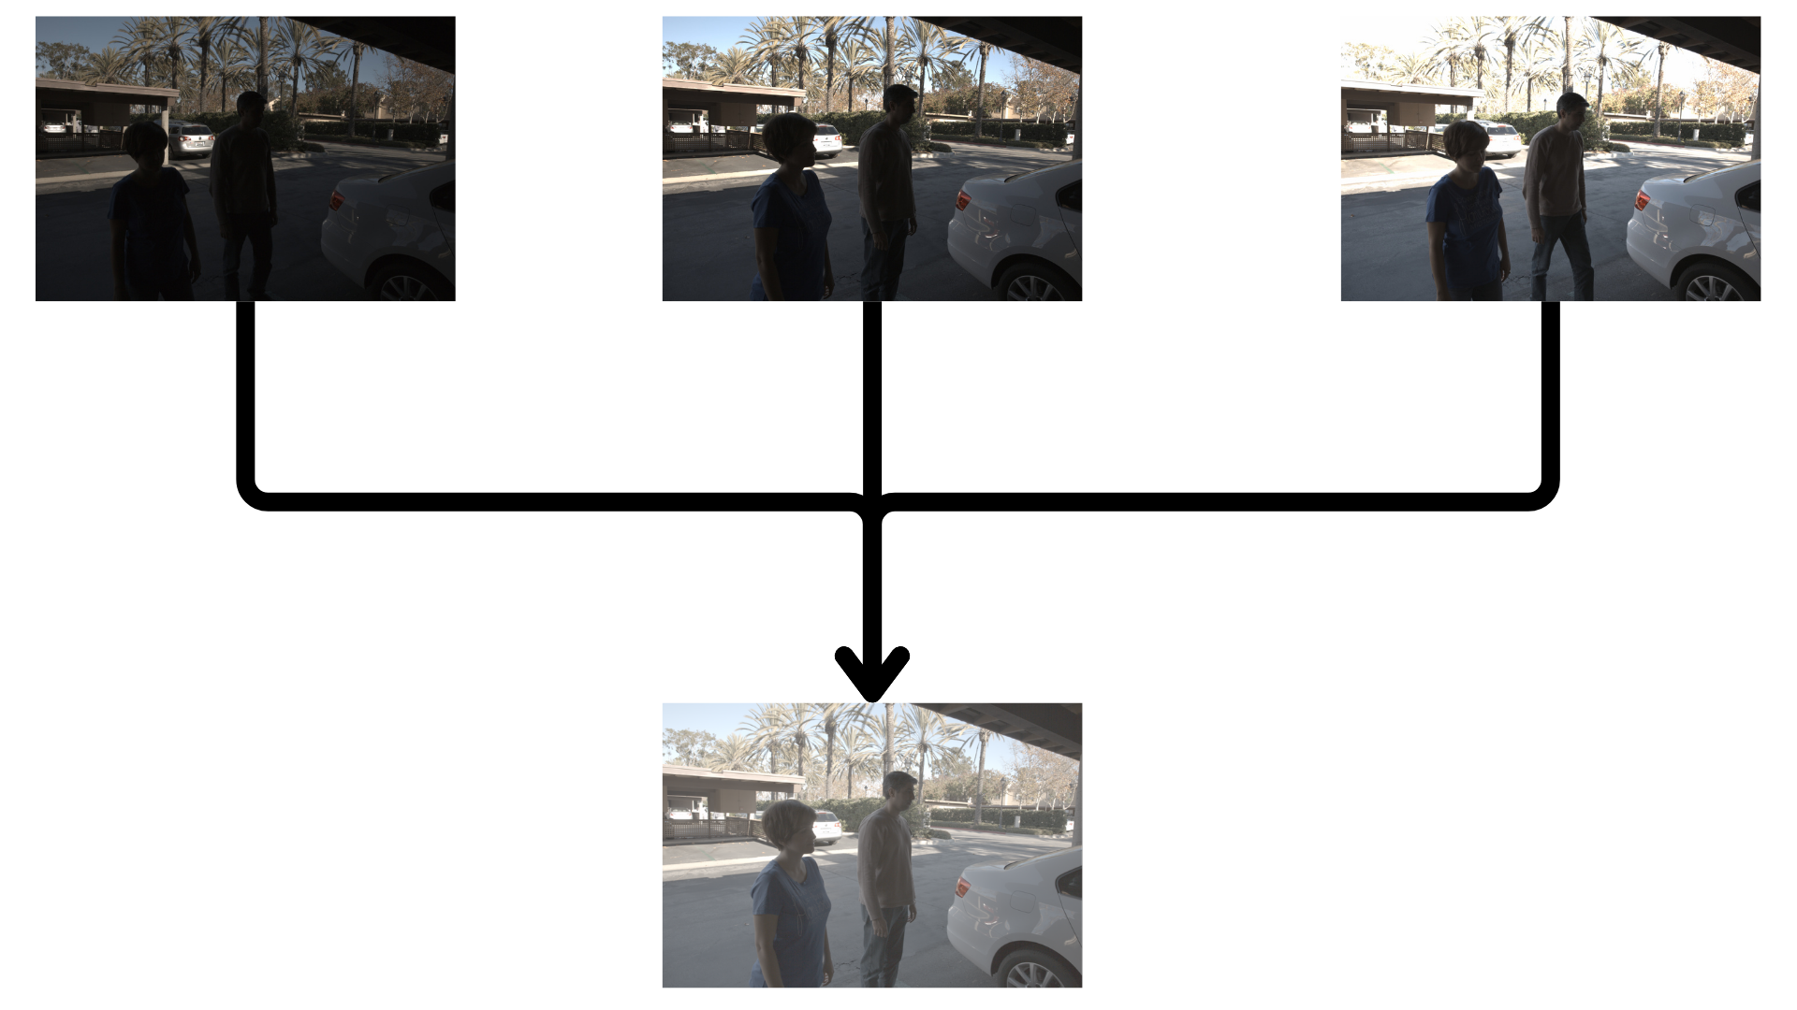
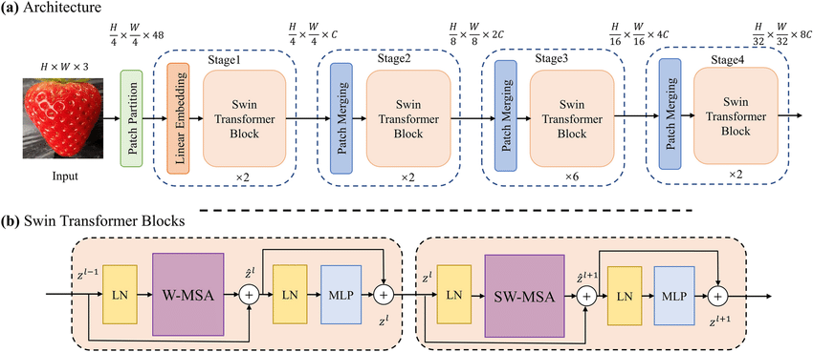
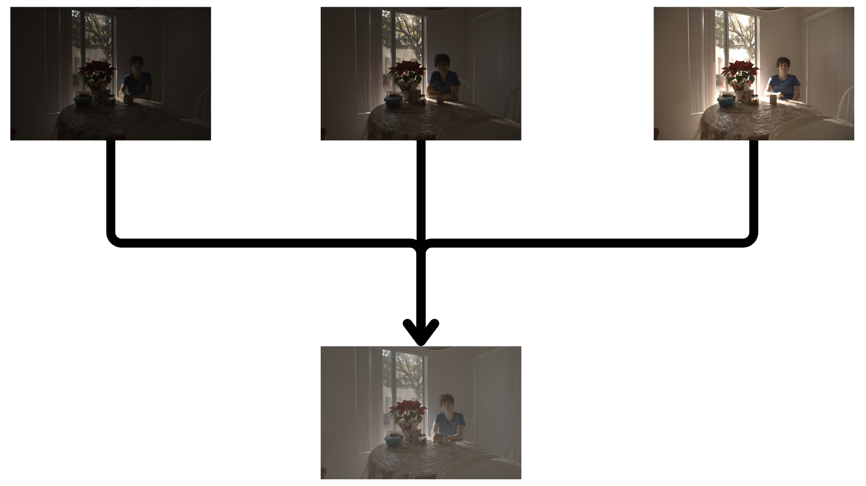
Conversion of LDR Images to HDR using AI
KLE Mentor: Basawaraj Nvidia Mentor: Animesh
Name – Darshan S, Iffrahkhan H, Shreya P, Aishwarya J
School of Electronics and Communication Engineering
Problem Statement
Proposed Framework
Results and Discussion
Our project aims to enhance the dynamic range of images/Frames captured using OMS (Occupant Monitoring System) cameras by implementing AI-based HDR reconstruction.
Objectives
The primary objective of this project is to design and implement an AI-based system that converts Low Dynamic Range (LDR) images into High Dynamic Range (HDR) images using deep learning. The specific goals include:
1. Implementing a Swin Transformer model for image translation
2. Training on the Kalantari HDR dataset
3. Evaluating with SSIM and L1 loss metrics
4. Generating HDR images from .tif LDR inputs
5. Producing outputs that closely match ground truth HDR images
Deliverables for Completion
1. Preprocessed Kalantari HDR dataset
2. Swin Transformer model implemented in PyTorch
3. Training/validation scripts with logging and augmentation
4. Trained model for LDR-to-HDR conversion
5. Generated HDR outputs from test images
6. Performance reports using SSIM and L1 loss
7. Final report and presentation with results
Conclusions
This project showcased the effectiveness of the Swin Transformer in converting LDR images to HDR, producing visually enhanced and structurally accurate results. The model successfully learned dynamic range reconstruction, as confirmed by strong evaluation metrics.
Minor Project: 2024-25
Notes:
1

